Slide 1
Giving Excuses
いいわけをすること

Slide 2
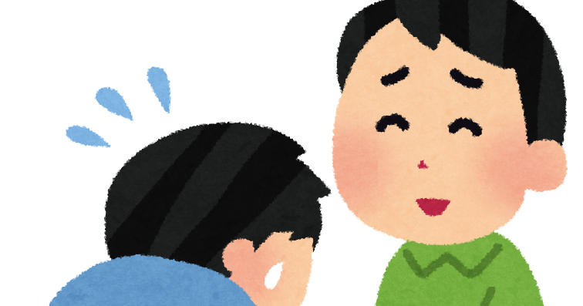
When you turn someone down, you want to be polite.
The grammar “I have to…” is very helpful for giving excuses!

Slide 3

Sorry, I have to keep studying.

Slide 4
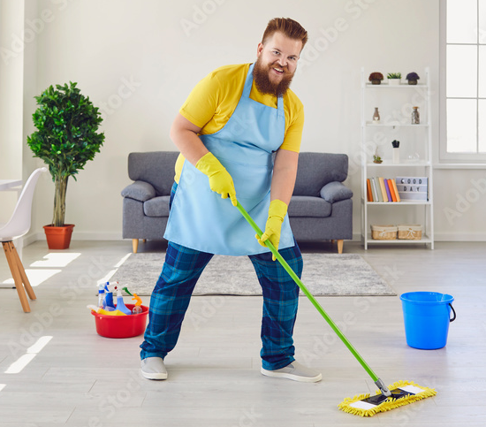
Sorry, I have to finish cleaning my room.

Slide 5
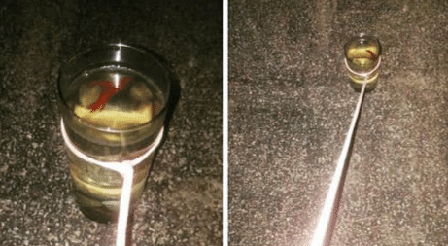
Anything can be an excuse.
Sorry, I have to walk my fish.

Slide 6

The
Ultimate Excuse:
Sorry, my mom said no.

Slide 7

So let’s say, I am your friend. I have a really mean cat. I do not want it, and neither do you.
But, I ask you,
“Will you watch
this cat for me?”

Slide 8
Rules:
Everybody stand up!
I will ask you to take the cat. Using:
I have to ~
or
I must ~
give me an excuse.
If you can give me an excuse, you can sit down. If you can’t, it’s your turn to ask.
One person can say “My mom said no”!
No repeating!
Notes:
One minute ish to think. Repeating is also off the table ofc。とりあえず文法正しく使えるなら何でもいいです

